Slide 1


AI for Parliamentary Intelligence: Enhancing Decision-Making in SADC Region
Transforming parliamentary operations through AI-powered intelligence systems
by Liberty Dandira(MIDLANDS STATE UNIVERSITY)
dandiral@msu.ac.zw
https://www.msu.ac.zw/
http://www.libertydandira.co.zw/
Notes:
This presentation explores how AI-powered intelligence systems can transform parliamentary operations in the SADC region.
The key focus is on enhancing decision-making capabilities for lawmakers through the application of advanced AI technologies.
The image on the slide depicts a modern, technology-enabled parliamentary chamber, reflecting the kind of environment where these AI systems could be deployed.
The diverse group of representatives engaged in debate highlights the need for intelligent tools to support complex policy discussions and deliberations.
My goal is to showcase how AI can elevate the quality of parliamentary intelligence and empower more informed, data-driven decision-making across the SADC region.

Slide 2





System Architecture Overview
Data Collection
Legislative documents, public feedback, media sources
AI Processing
Analysis, pattern recognition, insight extraction
Dashboard Generation
Customized visualizations for parliamentarians
Alert Distribution
Timely notifications via preferred channels
Notes:
This slide provides a high-level overview of the system architecture for our AI-powered parliamentary insights platform.
It highlights the four key components of the system: data collection, AI processing, dashboard generation, and alert distribution.
For data collection, we ingest a variety of sources including legislative documents, public feedback, and media reports.
The AI processing module analyzes this data, identifies patterns and trends, and extracts valuable insights.
These insights are then used to generate customized visualizations and dashboards for parliamentarians.
Finally, the system distributes timely alerts and notifications to users through their preferred communication channels.
The visual diagram helps illustrate the flow of information through the different stages of the system.
Overall, this architecture enables us to provide parliamentarians with a powerful, data-driven decision support tool.

Slide 3








Social Media Sentiment Tracking
Analyze
Collect
Process multiple languages and dialects
Gather posts across platforms
Recommend
Visualize
Suggest response strategies
Display sentiment trends by region
Notes:
Social media is a powerful source of real-time insights into how people feel about brands, products, and current events
Our platform collects posts across major social media platforms like Twitter, Facebook, and Instagram
We use advanced natural language processing to analyze the sentiment expressed in these posts, even in multiple languages and dialects
The data is then visualized to show sentiment trends by geographic region
This allows our clients to quickly identify emerging issues and respond with targeted strategies
Our recommendation engine suggests the best ways to address negative sentiment and capitalize on positive buzz

Slide 4
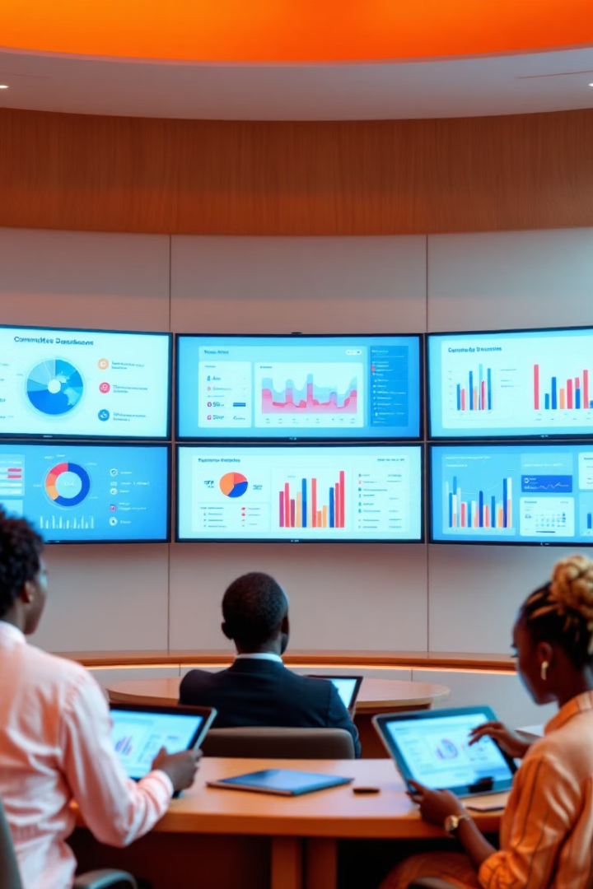
Committee-Specific Dashboards
Finance Committee
Health Committee
Budget performance metrics
Regional health statistics
Medical resource distribution
Economic indicators
Public spending impact
Disease outbreak alerts
Education Committee
School performance data
Educational access metrics
Resource allocation insights
Notes:
Committee-specific dashboards provide real-time data and insights to help parliamentarians make informed decisions for their respective policy areas.
The Finance Committee dashboard includes budget performance metrics, economic indicators, and analysis of public spending impact.
The Health Committee dashboard tracks regional health statistics, medical resource distribution, and disease outbreak alerts to support healthcare policy decisions.
The Education Committee dashboard presents school performance data, educational access metrics, and resource allocation insights to guide education policy.
These tailored dashboards empower committees to quickly access the most relevant information and identify trends to improve government oversight and service delivery.

Slide 5





Real-Time Parliamentary Alerts
Emergency Notifications
Immediate alerts for critical events
Session Reminders
Upcoming debates, votes, deadlines
Media Mentions
Press coverage of key legislation
Constituent Concerns
Trending public issues requiring attention
Notes:
Real-time alerts will help parliamentarians stay informed and responsive to critical events, upcoming sessions, media coverage, and constituent concerns
Emergency notifications provide immediate alerts for urgent situations requiring prompt action
Session reminders keep track of important debates, votes, and deadlines to ensure parliamentarians are prepared
Media mentions highlight press coverage of key legislation, allowing parliamentarians to address public discourse
Constituent concerns surface trending issues that require the parliamentarian's attention and action

Slide 6








Decision Support System Use Cases
Policy Impact Simulation
Forecast effects of proposed legislation
Historical Precedent Analysis
Compare to similar past legislation
Cross-Jurisdictional Comparison
Review similar laws in other countries
Budget Allocation Optimization
Identify highest-impact funding options
Notes:
Policy Impact Simulation: We can use our decision support system to forecast the effects of proposed legislation, helping policymakers understand the potential impacts before implementation.
Historical Precedent Analysis: By comparing proposed laws to similar past legislation, we can provide valuable context and insights to inform the decision-making process.
Cross-Jurisdictional Comparison: Reviewing how similar laws have been implemented in other countries can give us a broader perspective and highlight best practices.
Budget Allocation Optimization: Our system can analyze funding options to identify the highest-impact investments and help optimize budget allocations.

Slide 7
Ethical Considerations
Data Privacy
Algorithmic Bias
Transparency
Strict protocols for citizen information
Regular audits for fairness
Explainable AI decisions
Diverse training data requirements
Public disclosure of methodologies
Anonymization of personal data
Human oversight of recommendations
Clear documentation of sources
Secure storage with limited access
Notes:
• Data privacy is critical - we have strict protocols to protect citizen information, anonymize personal data, and limit access to secure storage.
• We regularly audit our algorithms for fairness and bias, use diverse training data, and maintain human oversight of recommendations to mitigate algorithmic bias.
• Transparency is a key principle - we strive for explainable AI decisions, public disclosure of our methodologies, and clear documentation of our data sources.

Slide 8




Implementation Roadmap
Phase 1: Assessment
Evaluate current systems and needs
3 months
Phase 2: Development
Custom dashboard creation
6 months
Phase 3: Training
Staff and parliamentarian education
3 months
Phase 4: Deployment
Phased rollout across committees
4 months
Notes:
This slide outlines the implementation roadmap for the parliamentary AI system project.
It breaks down the project into 4 key phases, each with a clear timeline and description of the activities involved.
Phase 1 is the assessment phase, where we'll evaluate the current systems and needs. This will take 3 months.
Phase 2 is the development phase, where we'll create the custom dashboard. This will take 6 months.
Phase 3 is the training phase, where we'll educate the staff and parliamentarians. This will take 3 months.
Phase 4 is the deployment phase, where we'll roll out the system across the committees. This will take 4 months.
The timeline shows this is a 16-month project with clear milestones along the way.
The icons and visual elements help make the timeline easy to understand at a glance.

