Slide 1
AI Transformation Begins with Purpose, Not Platforms
A Strategic Approach to AI Adoption and Growth
Dr. T. Magadza
@bhtmagadza

Slide 2
Agenda
Common misconceptions
Digital and AI transformation
AI Tools in Parliamentary Processes

Slide 3
"AI won't take your job, It is somebody using AI that will take your job."

Slide 4

Common Misconceptions
It’s All About Technology
Adopting new technologies (e.g., cloud, AI, automation tools).
Reality:
It’s about rethinking business models, processes, culture, and stakeholder experience.
Without organizational change, tech alone won’t lead to meaningful results.
Once implemented, the Transformation Is Complete
has a clear start and end.
Reality:
It’s an ongoing, iterative process responding changes in technological landscape

Slide 5
Common Misconceptions
AI is a tool—its success depends on data quality, proper use cases, change management, and integration into business processes.
It’s All About Cost-Cutting
Reduce costs through automation and digitization
Reality:
While efficiency is a benefit, the real value lies in innovation
AI Can Fix Everything
AI is a magical solution to all business problems.
Reality:

Slide 6
The true meaning of digital or AI transformation
It is about strategy and a change of mindset
⁠It is about using technology to reimagine and reinvent the core business itself.

Slide 7
AI Tools in Parliamentary Processes

Slide 8
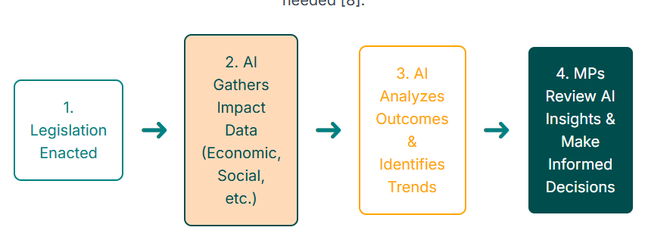
AI-Driven Post-Legislative Scrutiny Process

Slide 9
Natural Language Processing (NLP)
Legislative Research
Document analysis
Legislative drafting
Legislative amendments
Identifying experts
Identifying resources
Semantic search
Summarization
Translation
Parliamentary Oversight
Analyzing public submissions,
Identifying themes in feedback,
Analyzing economic data for conflicts of interest,
Public Engagement
Chatbots for information,
Analyzing public consultations
Summarizing citizen submissions
Plain-language summaries

Slide 10
Machine Learning (ML)
Legislative Research
Identifying patterns/trends
Post-legislative scrutiny
Mapping bills/amendments
Predicting economic trends
etc.
Parliamentary Oversight
Predicting policy outcomes
Budget scenario simulation
Fraud detection
Government performance monitoring
Public Engagement
Analyzing public consultations for less-represented groups,
Tagging citizen responses

Slide 11
Specific Tools

Slide 12
Legislative Research
Dito Legislative Insights AI:
Summarizes and tracks legislation
CoCounsel: AI assistant for legal research and document review
Lex Machina: Predictive analytics for legislative and judicial trends
Parliamentary Oversight
LegalVIEW BillAnalyzer: bill review, flags violations,
Robot Alice (Brazil): Monitors procurement for irregularities
Estonian Tax AI: Flags VAT fraud and high-risk entities
Public Engagement
i.AI Consultation Analyser: analyze public consultation responses
Extracts themes, generates summaries, and creates dashboards

Slide 13
Conclusion
Trust in AI grows with exposure and practical application.
Call to Action: Start small and build on successes
Final Thought: The true power of AI lies in its ability to transform and reimagine core functions.

