Slide 1



Advancing Parliamentary processes through Academic collaboration on Artificial Intelligence: An Overview
Prof. Eddie Mwenje - Vice Chancellor
Bindura University of Science Education

Slide 2
The AI Imperative for SADC Parliaments
Artificial Intelligence (AI) is a transformative force, redefining parliaments and influencing legislative processes and citizen engagement.
Parliaments across the SADC region face a "Hobson's Choice" – a forced adoption of digital technologies to enhance parliamentary practice.
Zimbabwe's Parliament recognizes AI as a "tectonic shift" for fulfilling constitutional obligations with greater efficiency, transparency, and responsiveness.
This aligns with Zimbabwe's Vision 2030 and the 10th Institutional Strategic Plan for 2025-2029, emphasizing modernization through technological innovation.
It also aligns with the Parliament’s strategic goal to modernize its operations by introducing contemporary technologies like AI

Slide 3

Parliamentary Core Functions Needing AI
Improved Legislative Research & Analysis: Analyze bills, amendments, trends, and global comparisons.
Identification of legislative priorities and Key Performance Indicators (KPIs)
Oversight Automation: Dashboards for real-time ministry performance.
Comparison of legal drafts with existing laws.

Slide 4
Parliamentary Core Functions Needing AI - 2
Legislative Efficiency: AI for summaries, fact-checks, transcriptions and translations.
Administration: Workflow & HR automation
Security: AI‑powered one source of truth to dispel misinformation
Parliament Representation: Engagement with the citizens

Slide 5
Key Examples of AI Use in Parliaments – Outside the SADC region (Source: IPU, 2024)
European Parliament: Archives Unit
Italian Senate: Classification of Laws
Brazilian Chamber of Deputies: for enhancing legislative processes and interacting with the citizenry
US House: Comparing bills
Dutch House: Automatic reporting
Japan National Council: Digital media analysis
India: Working on an AI model for the parliamentary processes use
Uganda: in the process of piloting AI tools in parliament

Slide 6

Key Opportunities for AI in Parliament
Enhanced Efficiency & Speed: Save hours in drafting and analysis.
Improved Legislative Quality: AI-enhanced precision, consistency.
Greater Public Engagement & Accessibility: Real-time interaction and comprehension.
Evidence-Based Decision Making: Aggregate and analyze big data.
Cost-Effectiveness and Modernization: High output with lower overhead.

Slide 7
Key AI Challenges for Parliaments
Infrastructure gap – Most parliaments lack the servers, networks, or cloud links needed to run AI tools.
Missing roadmap – Pilot projects stall because there’s no clear path from proof-of-concept to full roll-out.
Skills shortage – MPs and staff have limited data and tech know-how, with too few specialists to guide them.
Cautious culture – Traditional ways of working make it difficult to experiment with and adopt AI-powered solutions.

Slide 8
The Role of Universities in supporting Parliaments
Research & Development: Drive AI exploration and equity.
Capacity Building & Digital Literacy: Educate all stakeholders.
Policy & Ethical Guidelines: Create national AI ethics and privacy laws.
Training & Upskilling: Teach safe and ethical AI use.
Collaborative Partnerships: Share global best practices.
Development of AI systems and platforms for the Parliament

Slide 9
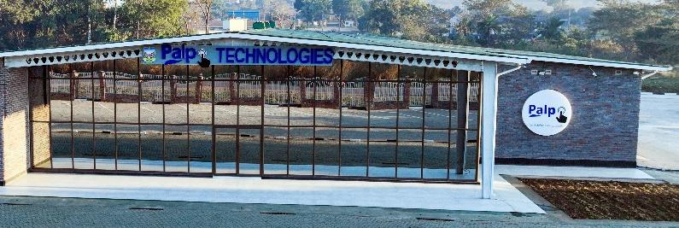
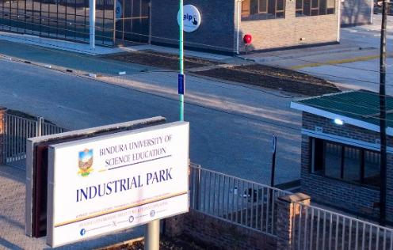
BUSE Industrial Park now assembles affordable phones, laptops & tablets—expanding device access and paving the way for an AI-literate Zimbabwe.

Slide 10
BUSE – PoZ Collaboration on AI Projects
Completed
In Progress
Administration and Workflow Management – Job applications, Leave Mgt, Procurement Mgt
Fleet Management – Shuttle Buddie
Training Management
Chiringa M & E Solution
Hansard Transcription and translation platform (Titus)
Parliament Access Control
MP Attendance Platform
Document Management
Bill Tracker
AI powered Chatbot for Citizen engagement
Training for parliamentarians and staff
Digitisation of all parliament documents

Slide 11
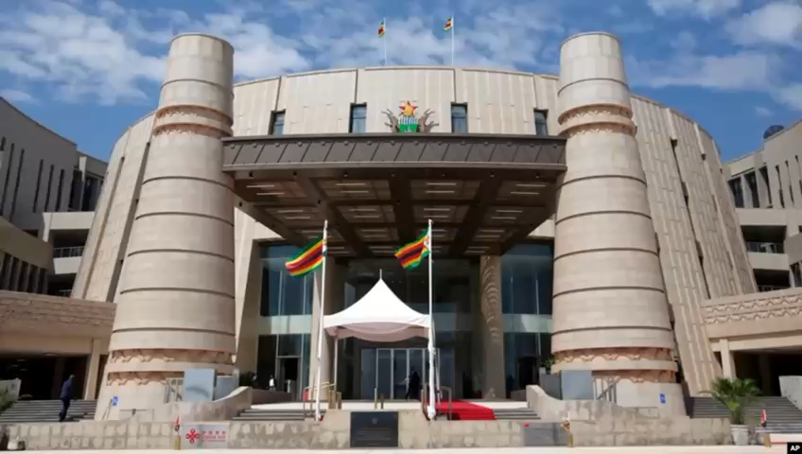
Parliament of Zimbabwe’s (PoZ) Administration and Workflow Management System

Slide 12
Conclusions
Digital leadership is non-negotiable.
Parliaments that master AI will shape the future; those that don’t will be shaped by it.
SADC, let us lead this revolution.
“A digitally advanced parliament is a stronger, more effective, more transparent and more accountable parliament.”
— Martin Chungong, IPU Secretary-General
We commend the Parliament of Zimbabwe for partnering with universities on AI initiatives—future-proofing its services for Zimbabwe’s 21st-century, tech-savvy citizens.

Slide 13
The End
Thank you,
Merci,
Obrigado

