Slide 1
Thinking “regulation” as SADC Parliaments harness Artificial Intelligence and legal technology for effective and efficient Parliamentary processes
Dr Tarisai MUTANGI
(University of Zimbabwe)

Slide 2
Introduction
A case for harnessing AI technology into Parliamentary processes;
Dealing with or addressing risks as AI technology is integrated;
Forms of regulation SADC Parliaments may consider; and
Way forward for the SADC Region.

Slide 3
Why harness AI into (which) Parliamentary Processes?
1. Enhanced Legislative Drafting
AI tools can assist in faster drafting of bills, model laws, checking for consistency, legal conflicts, or outdated references.
Improves productivity and reduces human error in legal text generation.
2. Enhanced Research and Analysis
AI-powered legal research tools can quickly analyze large datasets—legislation, analyse court decisions, policy documents—supporting better-informed decisions.
This enables real-time impact analysis of proposed laws.

Slide 4
Why harness …
3. Enhances Public Engagement
Tools such as natural language processing (NLP) and AI chatbots can summarize complex bills and enable citizens to provide feedback.
Generally makes parliamentary processes more accessible and inclusive.
4. Enhances Oversight and Monitoring
The tools may trace patterns in government behaviour such as spending, implementation of laws, or administrative decisions—enhancing accountability of decision-makers.
Enables proactive parliamentary oversight through predictive analytics and real-time updates.

Slide 5
Why harness …
5. Enhances Cost and Time Efficiency
Automation of routine tasks (e.g., document indexing, legislative tracking) reduces administrative burdens.
Creates time for more strategic legislative, policy and other urgent work.
6. Enhances Comparative Benchmarking
AI legal tools can help compare legislative, institutional and jurisprudential experiences between systems across countries to inform harmonization/fragmentation or law reform efforts.
This facilitates learning from global legislative best practices, although human oversight remains key.
7. Enhances Evidence-Based Law-making
When fully developed to its context, AI can analyze social, economic, and legal data to help lawmakers understand the potential consequences of legislation.
Encourages fact-based, data-driven legislative initiatives.

Slide 6
What is already happening around the world?
Around the world, Parliaments are already using AI—and the results are transformative.
Kenya’s Judiciary is using speech-to-text AI to transcribe court proceedings, saving time and backlog. This technology can be used to capture Parliamentary proceedings.
Brazil’s Congress’ AI tool ‘Ulysses’ scans proposed bills and alerts MPs to duplicate or unconstitutional clauses.
Estonia’s e-Government uses AI to automate legal compliance checks in minutes.
In South Africa’s Parliament, trials underway for machine learning models that sort thousands of submissions received during public consultations.
Canada’s Legislative Drafters use a Legaltech platform that suggests wording based on past laws, improving consistency and clarity.
These technologies are not flawless—but used wisely, they amplify rather than undermine parliamentary sovereignty.

Slide 7
AI Regulation
Its necessary to address potential risks and ensure its responsible development and deployment.
Without regulation to enforce accountability, AI systems could pose dangers to human life, privacy, and ethical standards.
Furthermore, unregulated AI can erode public trust, create security vulnerabilities, and potentially lead to unintended consequences.
Technology should serve democracy—not weaken it.
As Parliament integrates AI and Legal Technology, several foundational legal and ethical questions arise that go beyond operational efficiency and enter the realm of democratic integrity.

Slide 8
Is it all rosy?: Mischief that comes with harnessing AI
Accountability
Transparency and Explainability
Bias and Fairness
Legal and Ethical Uncertainty
Data Privacy and Security
Institutional Resistance and Capacity Gaps
Integration with Legacy Systems
Procedural and Constitutional Compliance

Slide 9

Emerging trends in AI Regulation/control

Slide 10
Data Protection: Southern African Development Community (SADC) Model Law (2013)
Not a form of AI regulation per se.
Its objective is to guide SADC Member states when adopting data protection legislation, to combat the violations of data likely to arise from the collection, processing, transmission, storage and use of personal data.
These aspects are now integral to the development and deployment of AI systems.
Such laws naturally form part of AI systems regulation.

Slide 11
The AU Strategy on AI
The AU Strategy was adopted by the AU Executive Council during its 45th Ordinary Session held on 18th – 19th July 2024, in Accra, The Republic of Ghana;
It has five focus areas:
Harnessing AI's benefits for African people, institutions, the private sector and countries, in line with Agenda 2063;
Addressing the risks associated with the increasing use of AI;
Accelerating AU Member States' capabilities in infrastructure, AI talent and skills, datasets, innovation and research that underpin AI development;
Fostering regional & international cooperation and partnerships to develop national and regional AI capabilities and advance Africa’s position on a global stage.
Stimulating public and private investment in AI at national and regional levels.

Slide 12
Amendment and application of existing laws and frameworks
Intellectual Property laws;
Electronic Communications and Transactions laws;
Whistleblowing and protected disclosure laws;
Access to information laws;
Personal data protection laws;
Cybersecurity laws;
Consumer protection laws;
Antitrust and competition laws;
Laws and policies pertaining to inclusion and empowerment of different groups (women, girls, people with disabilities, youth, children, rural population, etc.)

Slide 13
The European Union: Leading with "Hard Law" (The AI Act)
Took effect in 2024 after years of debate.
The world’s first comprehensive legal framework for AI.
It focuses on a risk-based classification of AI systems.
It distinguishes between unacceptable risk (e.g., social scoring, subliminal techniques), high-risk systems (such as AI used in healthcare or law enforcement), and limited-risk systems like chatbots.
It enforces transparency, fairness, and accountability, particularly in high-stakes sectors where AI could impact fundamental rights, safety, and privacy.
The law to be implemented in phases with prohibitions taking effect from February 2025, and full applicability for high-risk systems by early 2028.

Slide 14
Council of Europe Framework Convention on AI and Human Rights (2024)
Its a comprehensive legal framework designed to ensure that all activities within the AI lifecycle adhere to fundamental human rights, democratic principles, and the rule of law.
It applies to public and private actors, mandating that states implement graduated, context-specific measures to manage AI-related risks through risk and impact assessments, accessible remedies for affected individuals etc.
Parties to embed core principles such as transparency, accountability, and effective oversight throughout the design, development, deployment, and decommissioning of AI systems.

Slide 15
The United States: A Principles-Based & Sector-Specific Approach
The Approach focuses primarily non-binding principles, executive orders, and sector-specific guidance, rather than a single overarching AI law.
Key Initiatives used include the NIST AI Risk Management Framework; Executive Orders and State-level Initiatives.
The goal is to drive innovation, maintain global dominance in AI, address risks through existing regulatory structures, protect civil rights and privacy.
Fragmented approach.

Slide 16
Brazil
Brazil’s Proposed AI Regulation Bill 2023 aims to establish a framework for the ethical and responsible development, deployment, and use of AI systems.
Its built on four pillars: risk-based governance, human rights protection, transparency, and innovation.
AI systems must align with democratic values, safeguard user rights, and promote responsible innovation.
It covers any organization or individual that develops, deploys, or benefits from AI systems within Brazilian territory.

Slide 17
China: A Multi-Layered, Pragmatic & Control-Oriented Framework
Mixed Approach: Proactive, multi-layered regulatory framework, combining "hard law" with ethical guidance and "classified governance.“
The goals are to maintain social stability, control information, foster domestic AI leadership, ensure AI serves national strategic objectives.
Its unique features include adherence to state ideology.

Slide 18
Canada: A Principles-Based and Voluntary Approach (with legislative intent)
The Approach is currently leaning on principles and voluntary codes, but with ongoing legislative discussions for a comprehensive AI law
The ultimate Goal is to foster responsible AI innovation, build public trust, align with international best practices.
Establishes Advisory Council on AI & Safe and Secure AI Advisory Group to provide expert advice to the government.

Slide 19
Scope of Penalties
Fines.
Imprisonment.
Corrective orders.
Civil penalties.
Bans on deploying AI systems.

Slide 20
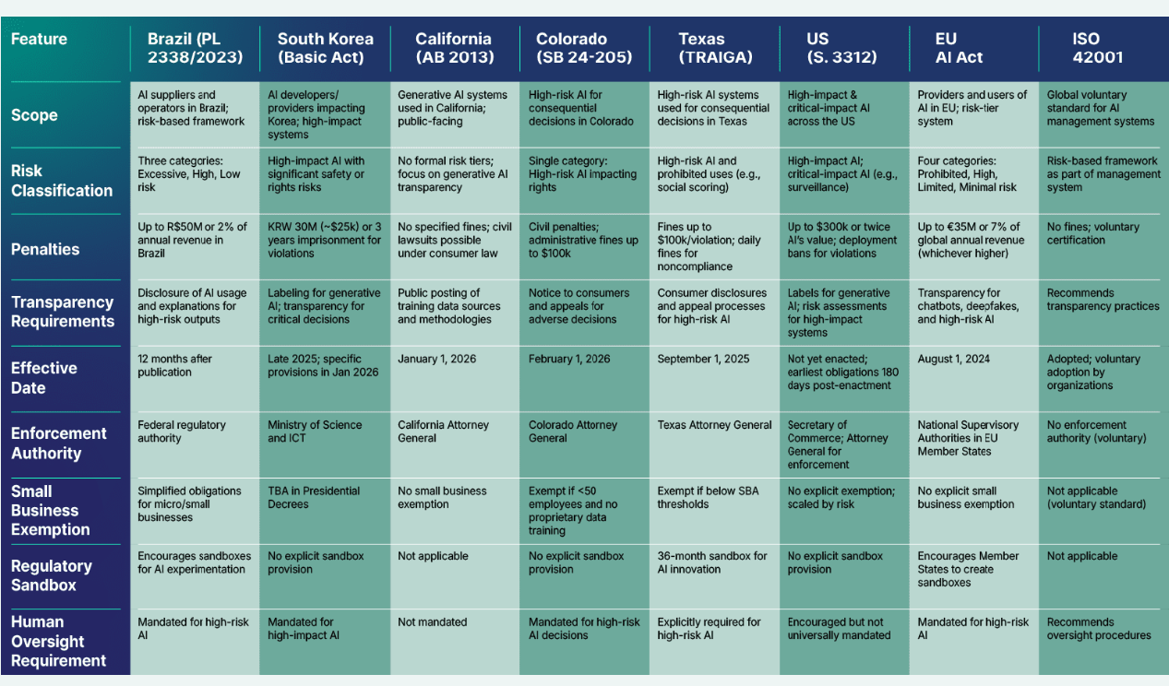
Side-by-Side Global AI Regulations

Slide 21
Key Lessons on Global AI Regulation
Diversity of Approaches: there is no consensus on the best regulatory model.
Risk-Based Frameworks: Many countries are adopting risk-based approaches to match regulations with potential impact of AI systems.
Balancing Act: A continuous challenge to balance innovation with necessary safeguards.
Principles-Based Foundations: most global efforts underpinned by common ethical principles (fairness, transparency, accountability).
International Collaboration: Growing recognition of the need for cross-border cooperation due to the global nature of AI.
Pacing Problem: Regulations struggle to keep pace with rapid technological advancements.
Enforcement is Key: The effectiveness of regulation depends on robust enforcement mechanisms. Jurisdictions establish enforcement bodies and impose penalties.

Slide 22
The Future of Regulation
Focus on Impact: Regulations should primarily focus on the societal impact and risks of AI, rather than just the technology itself.
Capacity Building: Governments and regulators need to build expertise in AI to effectively oversee its development and deployment.
Multi-Stakeholder Approach: Dialogue and collaboration among governments, industry, civil society, and academia are crucial.
Flexibility: Regulatory frameworks need to be agile and adaptable to evolving AI capabilities.
Harmonization: Efforts to align international standards and national frameworks, where possible, could reduce burdens and foster global innovation.

Slide 23
What role can the University of Zimbabwe play?
The University of Zimbabwe and other academic institutions, is ready to support SADC Parliaments directly or through the SADC-PF:
Training sessions for MPs, Speakers, clerks and researchers on AI tools relevant to their work.
Joint development of AI tools designed for the needs of Parliaments.
Provide evidence –based Independent advice on whether certain AI systems are fair and safe.
Provide Policy support for drafting rules and laws on AI technology use in governance.
We can even host Parliamentary Tech Fellows—young experts who help Parliaments test and use AI tools effectively.
Support government and the Parliaments in drafting model policies and legislation on AI integration that address the ethical concerns.

Slide 24
Conclusion: A smart Parliament is a strong Parliament
Ladies and Gentlemen, AI and Legal Technology are not about robots or science fiction. They are about:
Making Parliament faster, more informed and more responsive,
Helping MPs represent their people better;
Giving citizens better access to the laws that affect them.
Regulation of AI should not kill innovation in the sector.
The University of Zimbabwe is ready to walk this journey with you. It is committed to partnering with national and regional legislatures to build AI-enabled parliaments that remain people-anchored, law-governed and future-ready.

